Slide 1

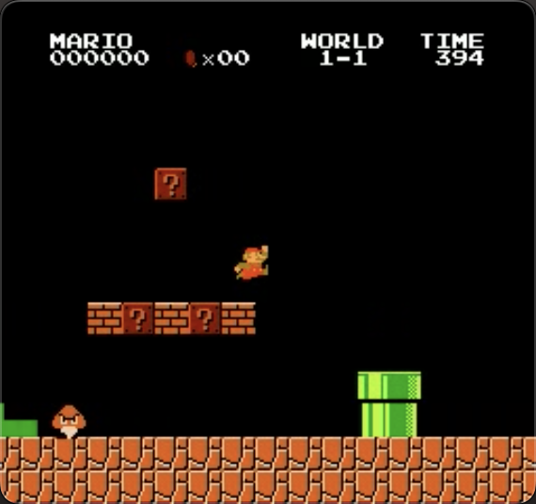
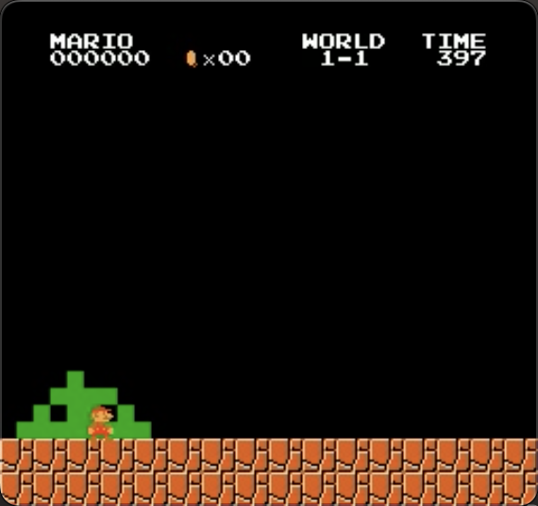
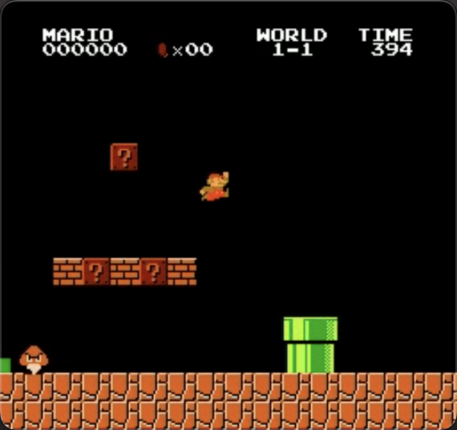
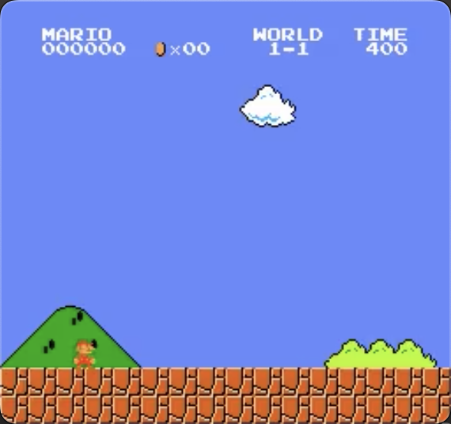
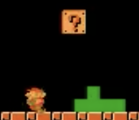
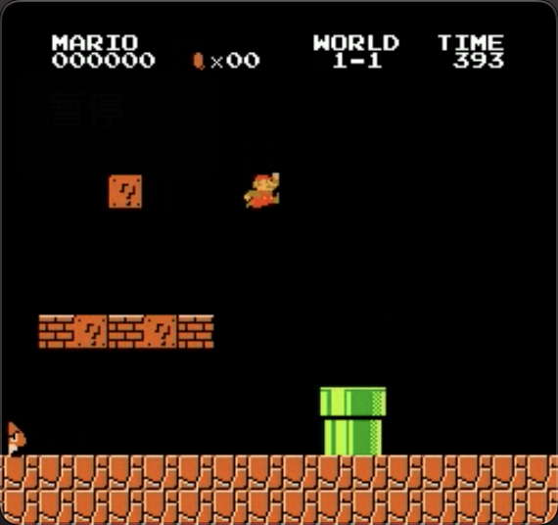
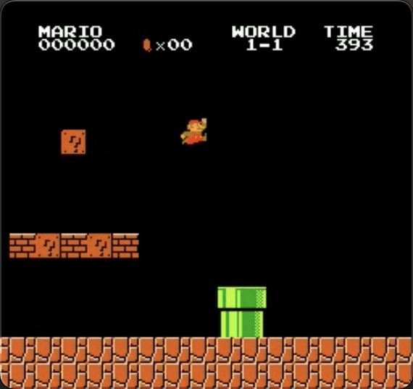

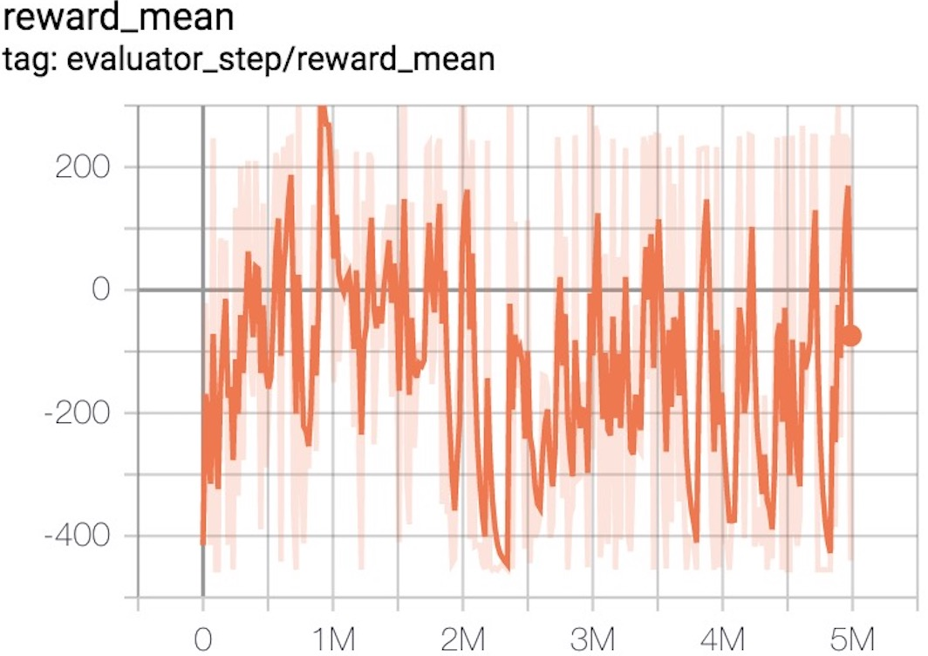
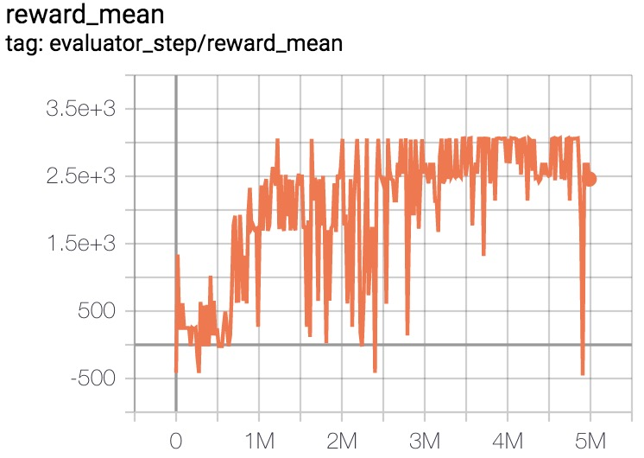
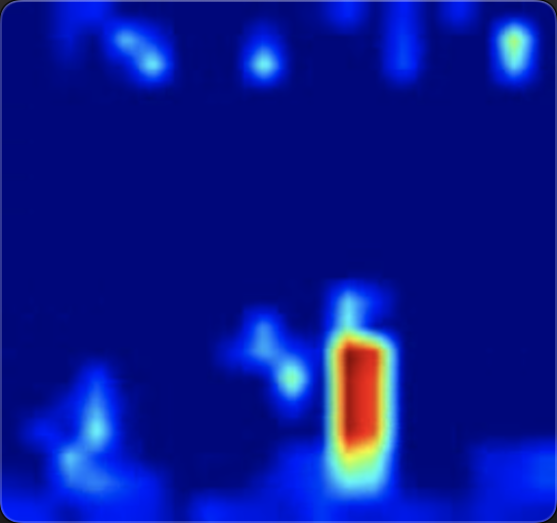
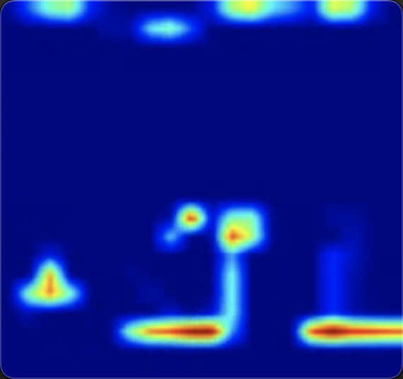
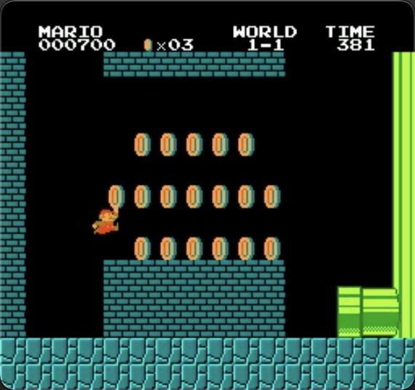
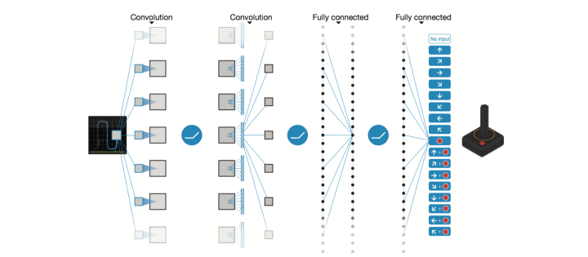
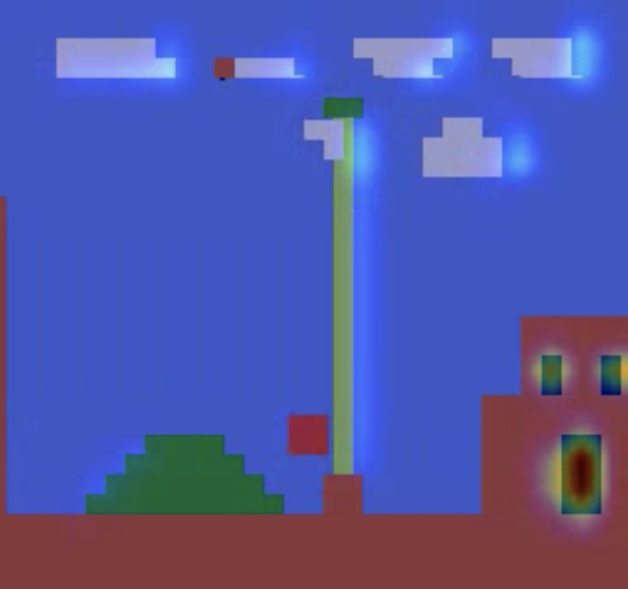
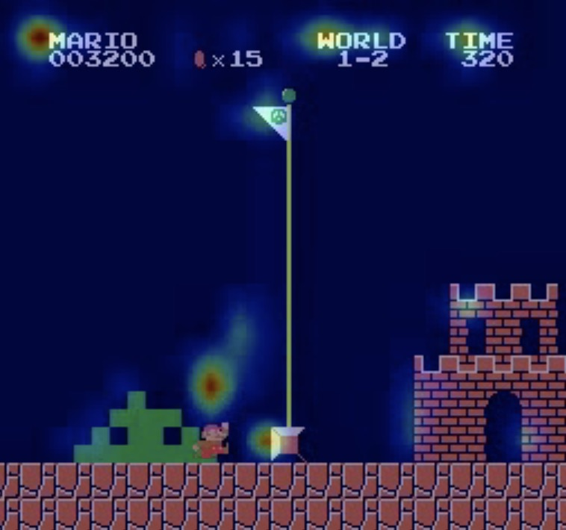
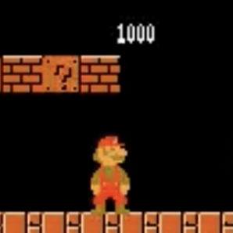

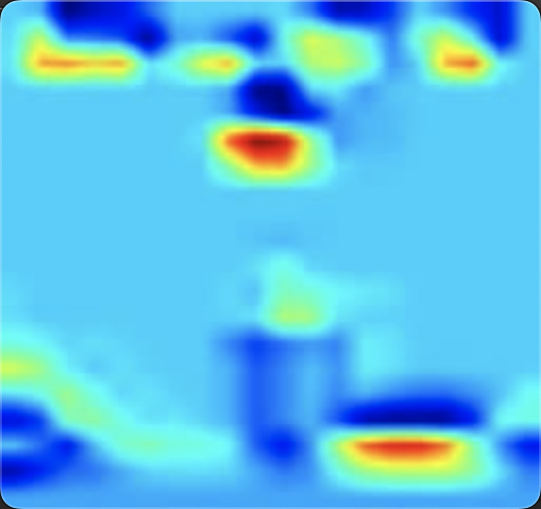
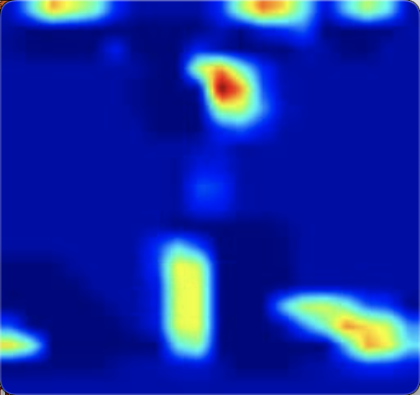
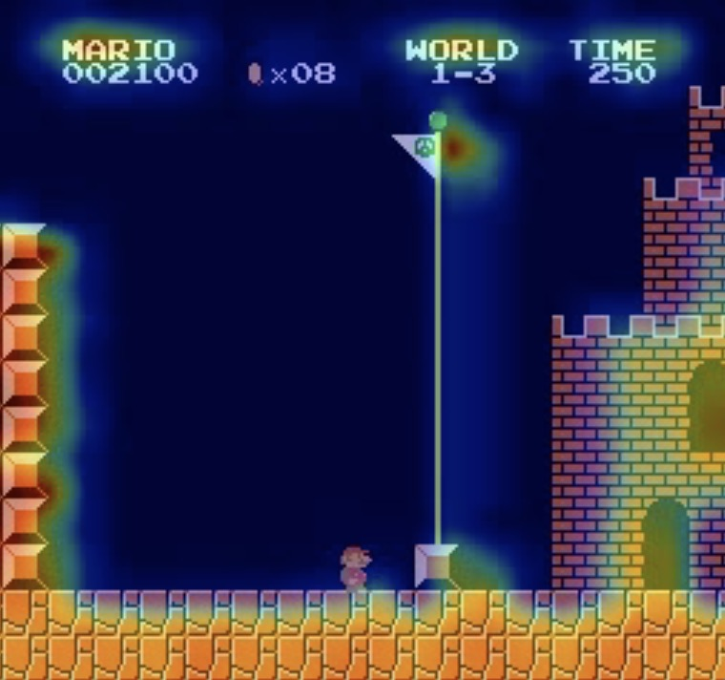
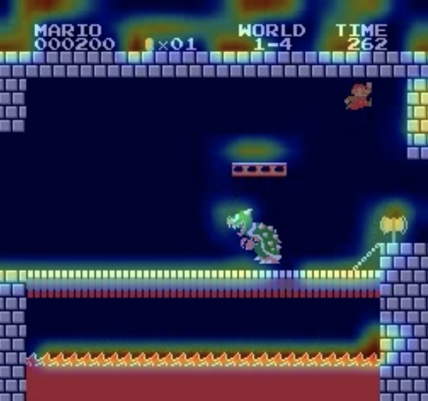
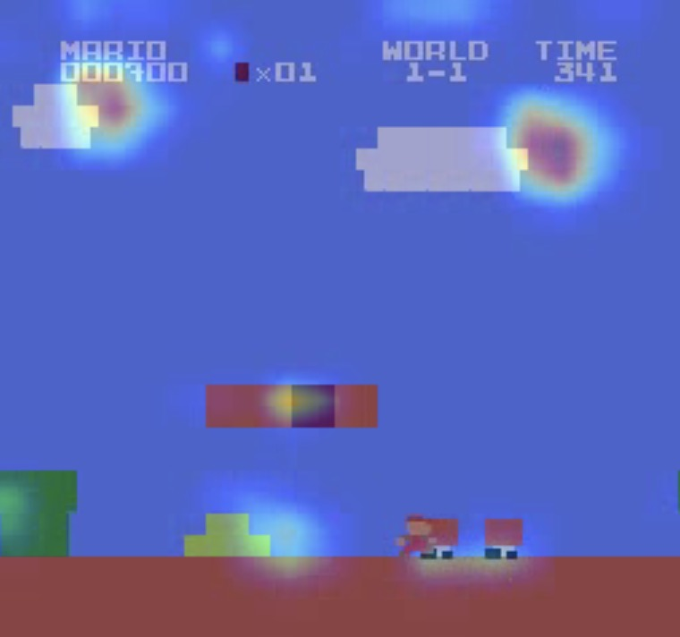
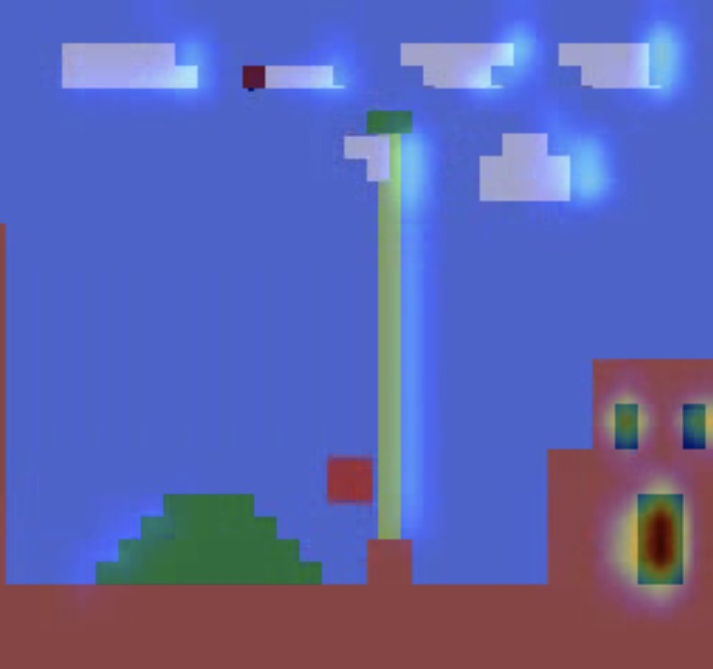
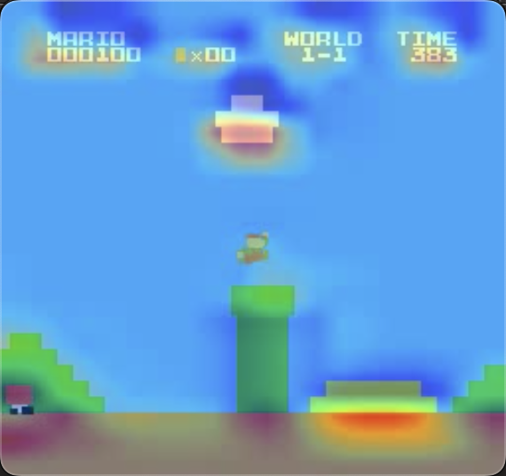
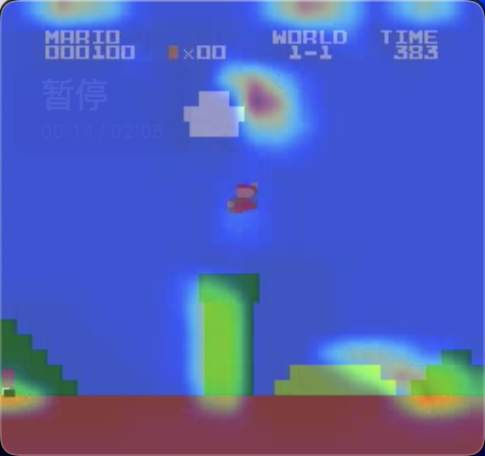
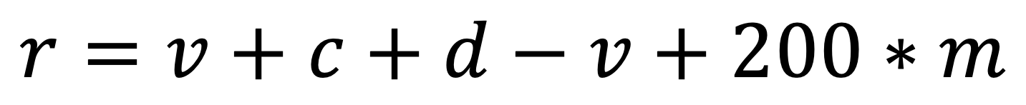
Feature Engineering Exploration of Super Mario Agent
Tao Lin, Fulin Wang, directed by Zhiyong Wu
Introduction of Our Work
Highlights
Experiments and Results
What:
Train a Mario agent with DQN. Conduct Feature Engineering Exploration. Implement additional functions e.g. fast pass , coins collect, level up.
How:
Set 18 sets of parameters to conduct 3 spaces(feature space, observation space, action space) e.g. write status reward to conduct action space.
1. The shortest time of passing 1-1: 55s
2. Mario learned to go down the hidden space to eat coins through pipe. (20 coins, 43s to finish)
3. Mario learned to level up by obtaining the mushroom.
1. 15 Baseline parameter combinations with 4 versions, 3 actions and 2 overlap selections utilized.
2. Three given ways and one customized way of modifying the Reward Space.
3. Exploration of four different stages.
v_1 to downsample
a_12 to learn deceleration
o_4 to overlap frames
In this work, we used DQN as the training model and use tensorboard, Class Activation Mapping(CAM) and average reward curve to show our result.
Sparse Wrapper
Best baseline
$$r=v+c+d−v+200∗m$$
Analysis:
1. The influence brought by different baseline parameters.
2. The reason that causes different passing time, and the reward w/o coins.
Representative Parameter Setting
5 sets (version, action, observation)
CAM
1-1 completion-v3
1-2 completion
v | a | o
0 | 7 | 1
1 | 2 | 4
1 | 12 | 4
2 | 12 | 4
3 | 12 | 4
Different
Downsample
Merged*
Codes and experiment results are at
https://github.com/lintaojlu/MarioAgent
1-3 completion
1-4 completion
* Items in Red indicates the best parameters, items in blue can’t convergence and the right images tell why

Slide 2
